Slide 1
New York City Parking Tickets

Slide 2
Data Source
From NYC OpenData
Fiscal Year 2014 : https://data.cityofnewyork.us/City-Government/Parking-Violations-Issued-Fiscal-Year-2014/jt7v-77mi
Fiscal Year 2015: https://data.cityofnewyork.us/City-Government/Parking-Violations-Issued-Fiscal-Year-2015/c284-tqph
Fiscal Year 2016: https://data.cityofnewyork.us/City-Government/Parking-Violations-Issued-Fiscal-Year-2016/kiv2-tbus
Fiscal Year 2017: https://data.cityofnewyork.us/City-Government/Parking-Violations-Issued-Fiscal-Year-2017/2bnn-yakx

Slide 3
Hardware Specifications - Google Dataproc
-Master node
Standard (1 master, N workers)
-Machine type
n1-standard-4 (4 vCPU, 15.0 GB memory)
-Primary disk type
pd-standard
-Primary disk size
500 GB
-Worker nodes
2
-Machine type
n1-standard-4 (4 vCPU, 15.0 GB memory)
-Primary disk type
pd-standard
-Primary disk size
500 GB

Slide 4
Hardware Specifications cont.
Image Version:1.3.45-debian9
Applications: Hadoop 2.9.2, Spark 2.3.4, Hive 2.3.5, Pig 0.17.0, Tez 0.9.2

Slide 5
Ticket Summary
CREATE EXTERNAL TABLE IF NOT EXISTS tickets_summary
(summons_number INT, plate_id STRING, vehicle_make STRING, vehicle_body_type STRING, vehicle_color STRING, violation_code STRING, registration_state STRING)
ROW FORMAT DELIMITED FIELDS TERMINATED BY ','
STORED AS TEXTFILE LOCATION '/output/tickets_summary'
TBLPROPERTIES ('skip.header.line.count'='1');
INSERT OVERWRITE TABLE tickets_summary SELECT summons_number, plate_id, vehicle_make, vehicle_body_type, vehicle_color, violation_code, registration_state FROM tickets;
select * from tickets_summary LIMIT 10;

Slide 6
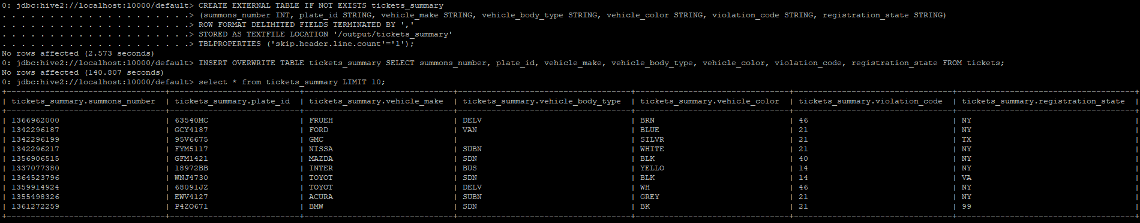
Results

Slide 7
Displaying certain information by plate id
SELECT * FROM tickets_summary WHERE plate_id LIKE 'GFM1421' LIMIT 1;

Slide 8
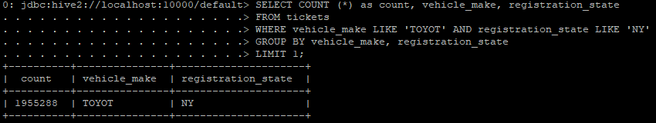
How many tickets were given to Toyotas in NY
SELECT COUNT (*) as count, vehicle_make, registration_state
FROM tickets
WHERE vehicle_make LIKE 'TOYOT' AND registration_state LIKE 'NY'
GROUP BY vehicle_make, registration_state
LIMIT 1;

Slide 9
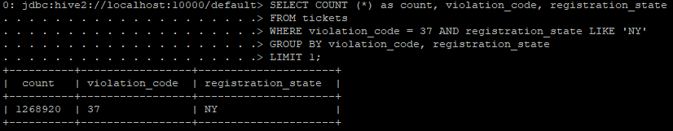
How many tickets were given because of expired meters in NY
SELECT COUNT (*) as count, violation_code, registration_state
FROM tickets
WHERE violation_code = 37 AND registration_state LIKE 'NY'
GROUP BY violation_code, registration_state
LIMIT 1;

Slide 10
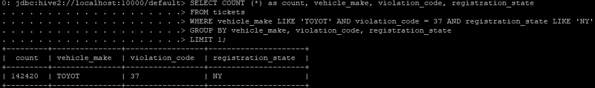
How many Toyotas were given tickets because of expired meters in NY
SELECT COUNT (*) as count, vehicle_make, violation_code, registration_state
FROM tickets
WHERE vehicle_make LIKE 'TOYOT' AND violation_code = 37 AND registration_state LIKE 'NY'
GROUP BY vehicle_make, violation_code, registration_state
LIMIT 1;

Slide 11
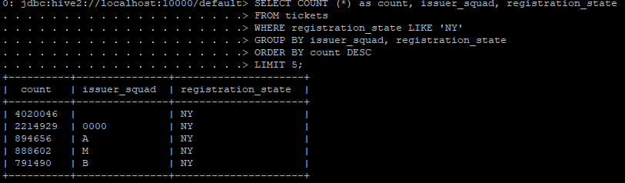
Top 5 police squads that gave out tickets in NY
SELECT COUNT (*) as count, issuer_squad, registration_state
FROM tickets
WHERE registration_state LIKE 'NY'
GROUP BY issuer_squad, registration_state
ORDER BY count DESC
LIMIT 5;

Slide 12
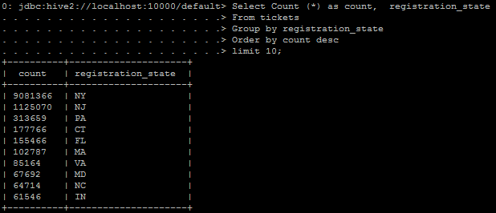
Top 10 Registration State by number

Slide 13
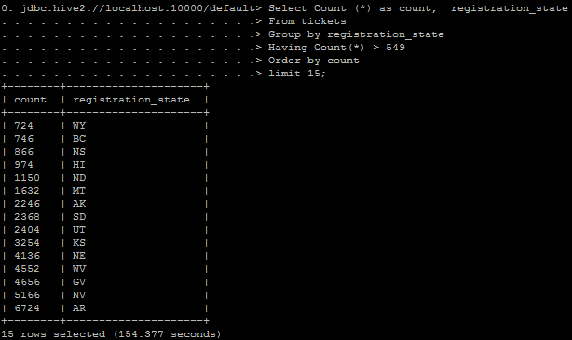
Bottom 15 Registration State by number

Slide 14
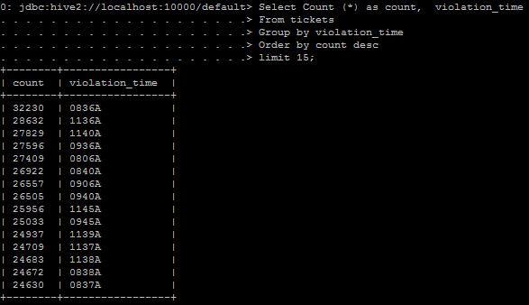
Top 15 Violation times

Slide 15
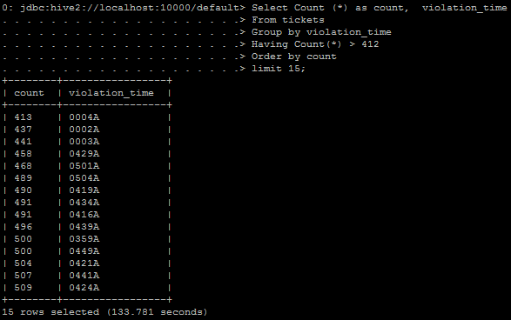
Bottom 15 Violation time

Slide 16
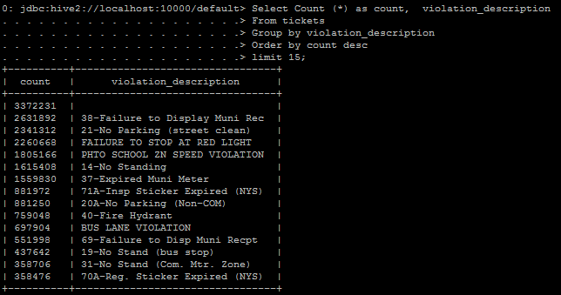
Top 15 Violations

Slide 17
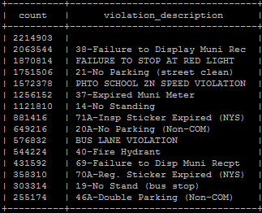
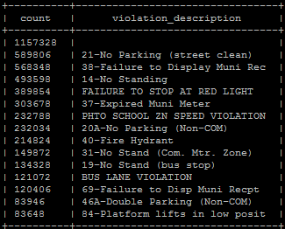
New York VS Non-New York Violations
(New York)
Not New York

Slide 18
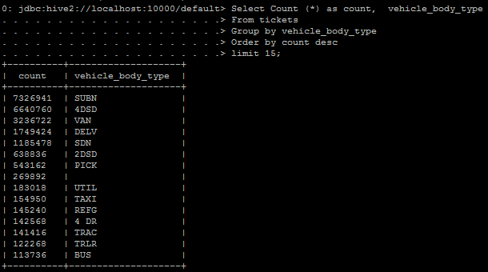
Top 15 Vehicle Body Types

Slide 19
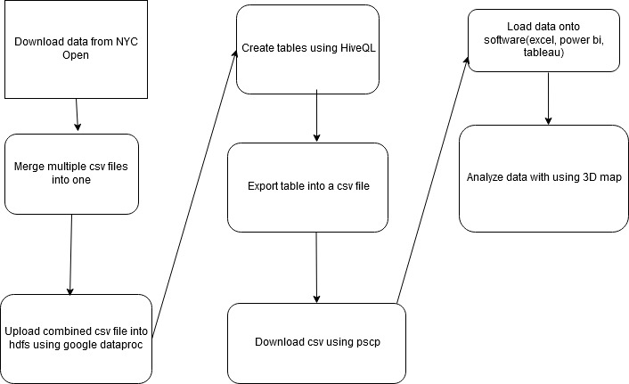

Slide 20
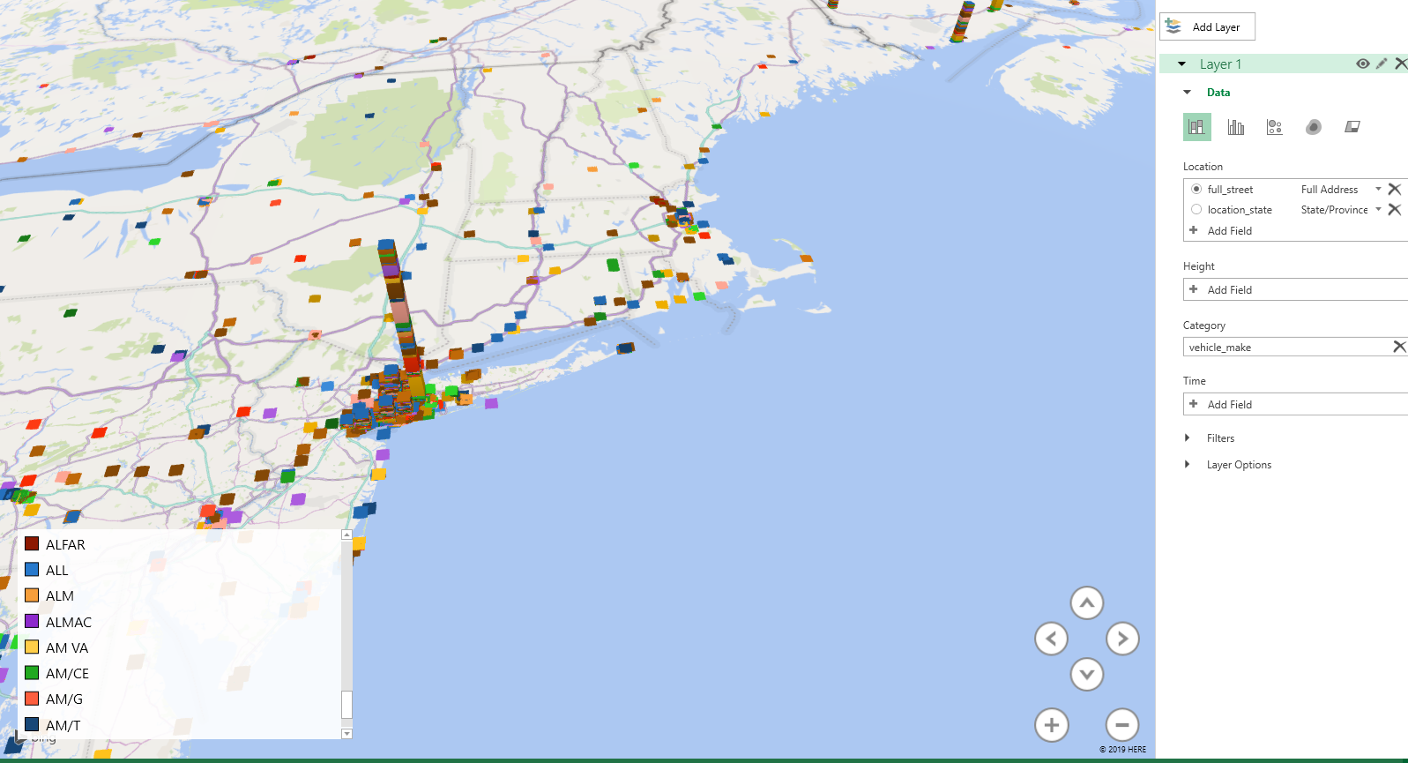
Visualization

